Slide 1

SMART SILO MONITORING AND INTELLIGENT BUFFER STOCK MANAGEMENT SYSTEM
TEAM NAME: PRIME PREDATORS
TEAM MEMBERS: 1)T HARIHARAN
2)M GANAPATHY
3)HARSHITH
HACKATHON NAME:ELECTROHACK2.0
DATE:08/02/2026

Slide 2
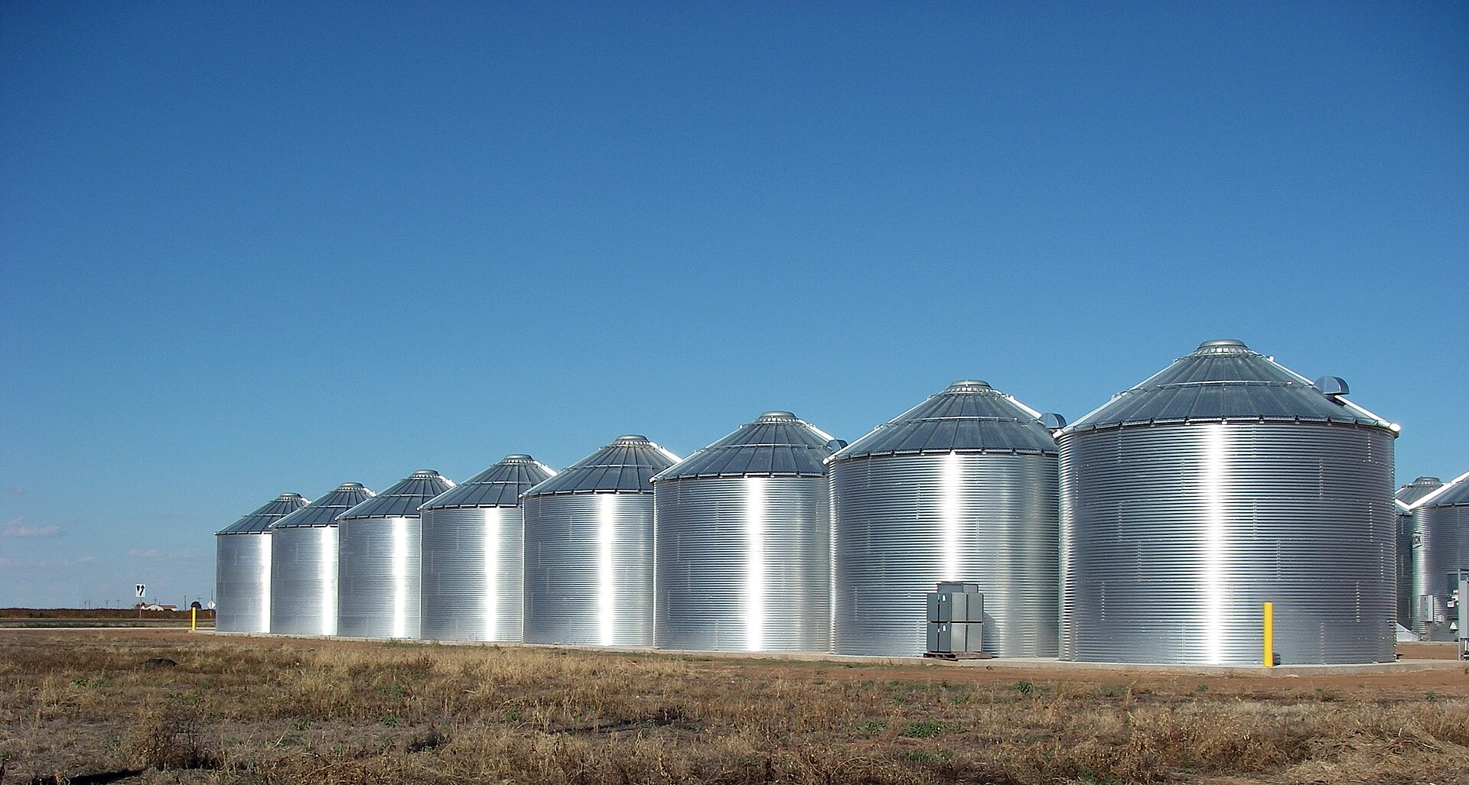
PROBLEM STATEMENT
Storage silos are essential for maintaining food supply chains, yet current systems lack intelligence and predictive capabilities.
Key Challenges:
No real-time monitoring of grain levels
Static buffer stock thresholds
Grain spoilage due to uncontrolled temperature and humidity
Undetected gas formation and pest infestation
No demand forecasting or weather-based planning
Impact:
Post-harvest losses (India loses ~5–10% grains annually due to poor storage)
Supply-demand mismatch
Financial loss for farmers and distributors
Increased operational inefficiency
Core Gap:
Existing systems are reactive rather than predictive.
There is a need for an intelligent, low-cost, real-time silo monitoring and predictive buffer management system.
This Photo by Unknown Author is licensed under CC BY-SA

Slide 3
Project Overview
System Workflow:
Sensors (ESP32) → Data Collection → ML Prediction Layer → Stock Risk Analysis → Dashboard + Alerts
What Makes It Smart?
Predictive rather than reactive
Combines historical and real-time data
Generates actionable recommendations
Low-cost and scalable for rural deployment
SmartSilo is an IoT-enabled decision-support system that integrates:
Real-time environmental sensing (temperature, humidity, gas levels)
Grain level monitoring using ultrasonic sensing
ML-based weather prediction
ML-based demand forecasting
Automated stock recommendation system
Cloud-based public dashboard visualization

Slide 4

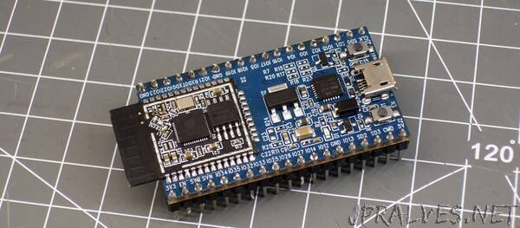
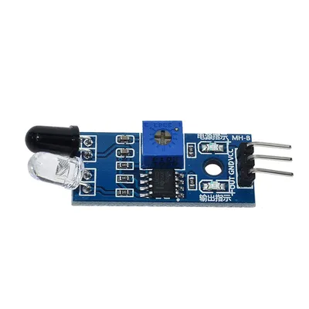

Technology Stack
Hardware:
ESP32 Microcontroller
Ultrasonic Sensor (Grain Level)
DHT11 (Temperature & Humidity)
MQ135 (Gas Detection)
IR Sensor (Flow Detection)
Servo Motor (Automated Lid Control)
Software:
Python
Flask (Backend)
Streamlit (Public Dashboard)
Pandas (Data Handling)
Machine Learning Models (Rain & Demand Prediction)

Slide 5

Alignment with Sustainable Development Goals (SDGs)
SDG 2 – Zero Hunger
Reduces post-harvest grain losses
Improves food storage efficiency
SDG 9 – Industry, Innovation & Infrastructure
Introduces smart infrastructure in agriculture
Promotes IoT-enabled rural digitization
SDG 12 – Responsible Consumption & Production
Minimizes waste through predictive buffer management
Enables data-driven inventory planning
SDG 13 – Climate Action
Weather-aware stock planning
Reduces unnecessary transportation and energy waste

Slide 6
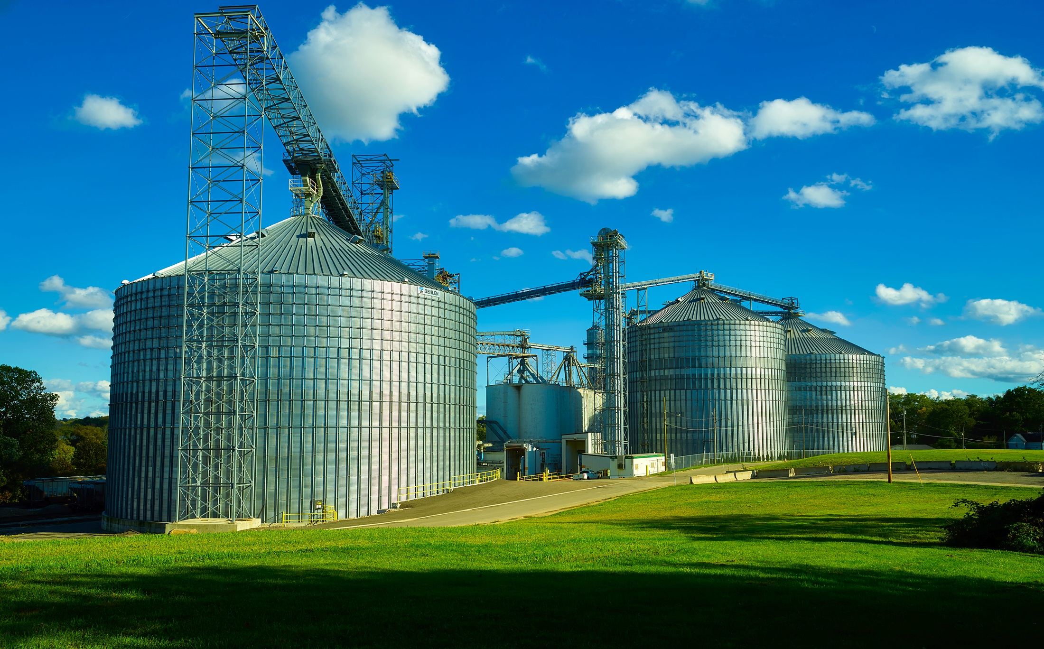
Real-World Applications
Government food storage warehouses
FCI storage centers
Agricultural cooperatives
Cold storage systems
Rural farmer collectives
Supply chain logistics hubs
Future Scope:
Integration with government procurement systems
SMS alerts for rural farmers
Multi-silo network optimization
AI-based spoilage prediction models

Slide 7
ML MODELS USED
MODEL 1: RAIN PREDICTION (CLASSIFICATION)
INPUT: TEMPERATURE, HUMIDITY
MODEL 2: DEMAND PREDICTION (REGRESSION)
INPUT: PREVIOUS DEMAND + RAIN PREDICTION
OUTPUT: NEXT-DAY DEMAND FORECAST
THIS HELPS IN INTELLIGENT BUFFER STOCK MANAGEMENT.
OUTPUT: RAIN / NO RAIN
MACHINE LEARNING INTEGRATION

Slide 8
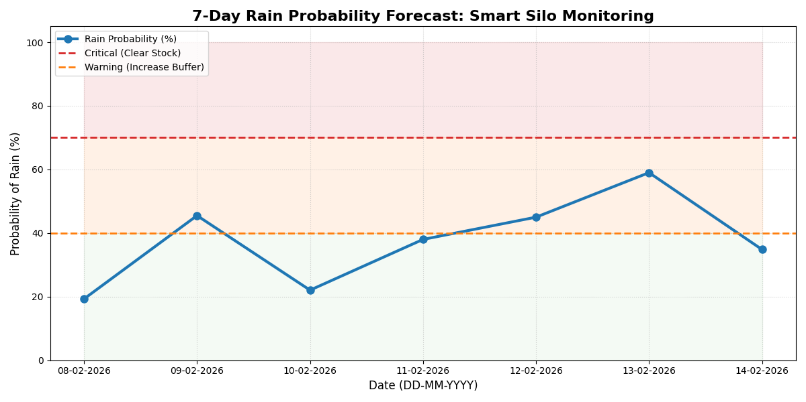
Machine Learning Model – Rainfall Prediction
Input Features:
Historical rainfall data
Current temperature (DHT11)
Current humidity (DHT11)
🔹 Output:
Predicted rainfall probability for a given day
🔹 Why Random Forest?
Handles non-linear relationships effectively
Robust against overfitting
Performs well with mixed historical and real-time features
🔹 Impact on System:
Enables proactive stock management
Helps prevent spoilage during high humidity/rain conditions
Improves decision-making for perishable grain storage

Slide 9
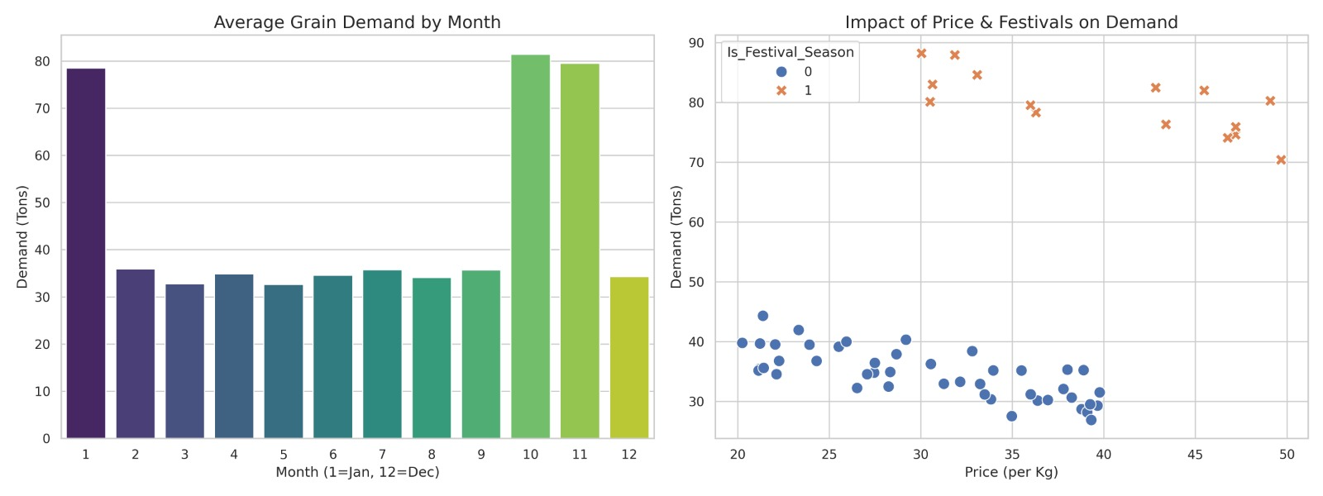
Machine Learning Model – Demand Forecasting
A Random Forest model was used to forecast grain demand trends.
🔹 Input Features:
Historical demand dataset
Historical pricing data
🔹 Output:
Demand vs Price relationship
Forecasted demand levels
🔹 Why Random Forest?
Captures complex market behavior patterns
Suitable for regression-based forecasting
Provides stable predictions across varied datasets
🔹 Impact on System:
Enables intelligent buffer stock planning
Prevents overstocking and shortages
Supports cost-efficient supply chain management

